Slide 1
State Machine
CSE 232 Computer Systems Fundamentals
Lecture 11
Dr Gamal Fahmy
Galala University

Slide 2
State Machine
Any device that has memory and a control/clock input is called a sequential machine. Latches, flip-flops, and ripple counters are examples of sequential machines.
When devices are synchronized so that all of their states change in synchronism with a clock pulse, we call them synchronous sequential machines or simply synchronous machines or STATE MACHINES.

Slide 3
State Machine
To design synchronous machines, we’ll need four tools:
  Karnaugh Map
  State Definition Table - A table listing all states, what they mean in plain English, and the binary value assigned to each state. (Toughest)

Slide 4
State Machine
  State Diagram - a directed graph with nodes representing states, arrows representing valid state transitions and annotations (on arrows) indicating the input conditions causing these transitions.
State
[Output]
Input(s)
X₁,X₂
  Transition Table - A listing of all possible state and input combinations, and the corresponding state transitions.

Slide 5
Analysis of Sequential Circuits
J
Clk
K
Q
Q
A
JK
Flip Flop
x
J
Clk
K
Q
Q
B
JK
Flip Flop
CLK

Slide 6
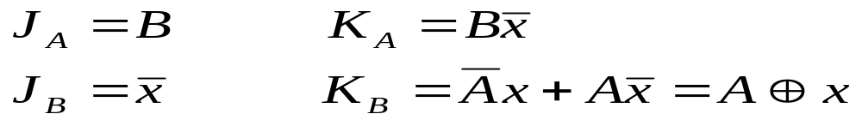
Analysis of Sequential Circuits
Present State |  | Input | Next State |  | Flip Flop Inputs
A | B | x | A | B | JA KA | JB KB
0 | 0 | 0 | 0 | 1 | 0 0 | 0
0 | 0 | 1 | 0 | 0 | 0 0 | 0 1
0 | 1 | 0 | 1 | 1 | 1 | 0
0 | 1 | 1 | 1 | 0 | 0 | 0 1
1 | 0 | 0 | 1 | 1 | 0 0 | 1
1 | 0 | 1 | 1 | 0 | 0 0 | 0 0
1 | 1 | 0 | 0 | 0 | 1 | 1
1 | 1 | 1 | 1 | 1 | 0 | 0 0

Slide 7
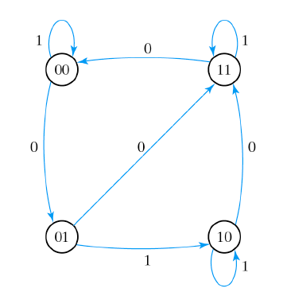
Analysis of Sequential Circuits

Slide 8
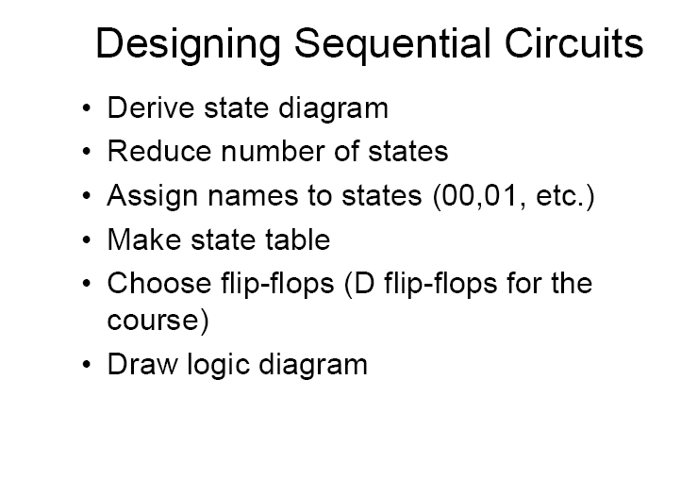
Design of State Machine
Slide Taken from Dr Kareem Darwish

Slide 9
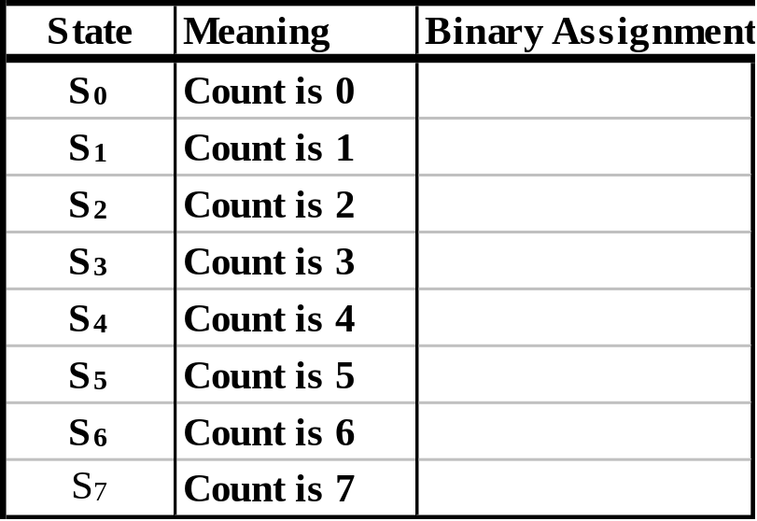
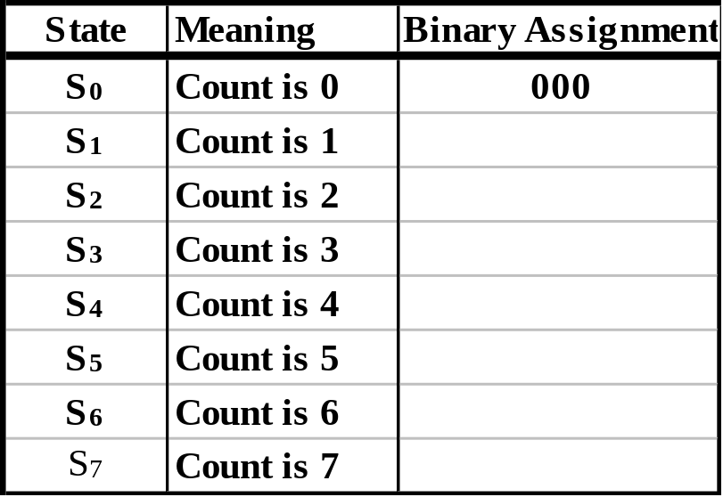
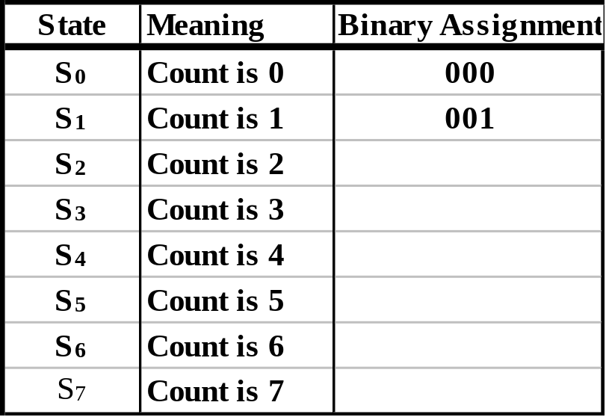
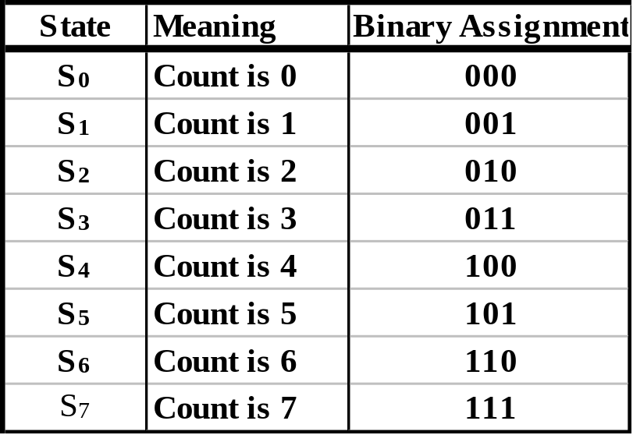
State Machine
EX: Build a 3-bit synchronous binary up/down counter using T flip-flops. Up(Down) when Up/Down =1(0).
State (Transition) Diagram
State Definition Table
1
S₀
S₇
0
1
0
0
1
S₁
S₆
1
0
0
1
S₂
S₅
1
0
0
1
0
S₃
S₄
1

Slide 10
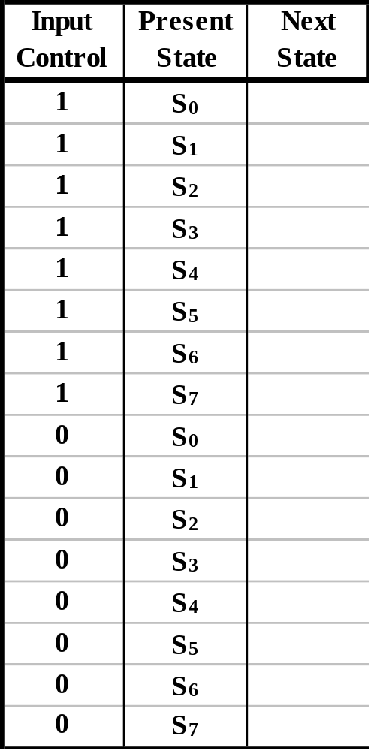
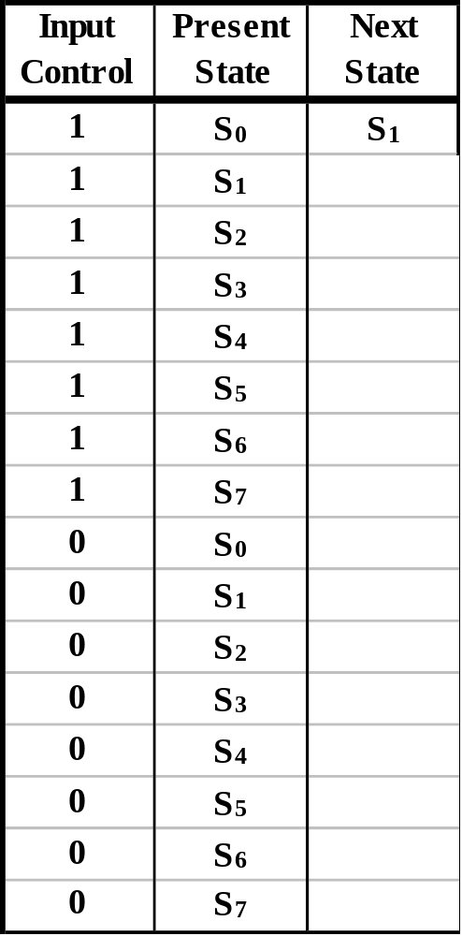
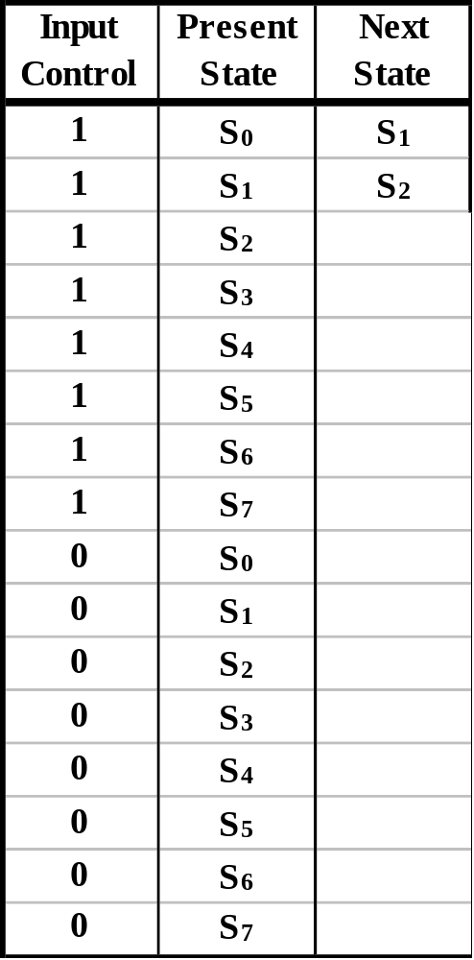
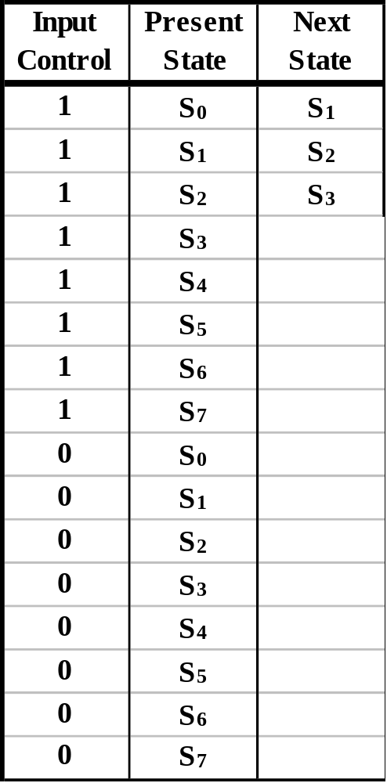
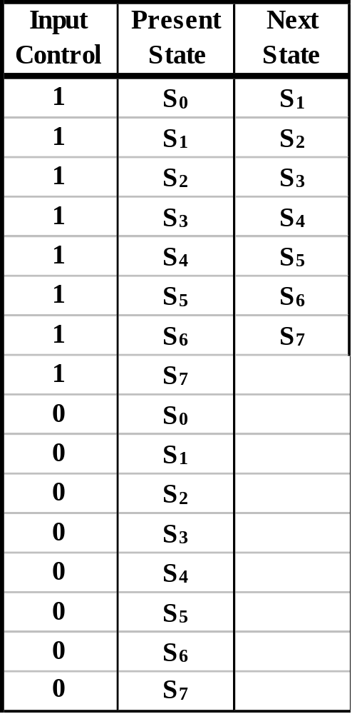
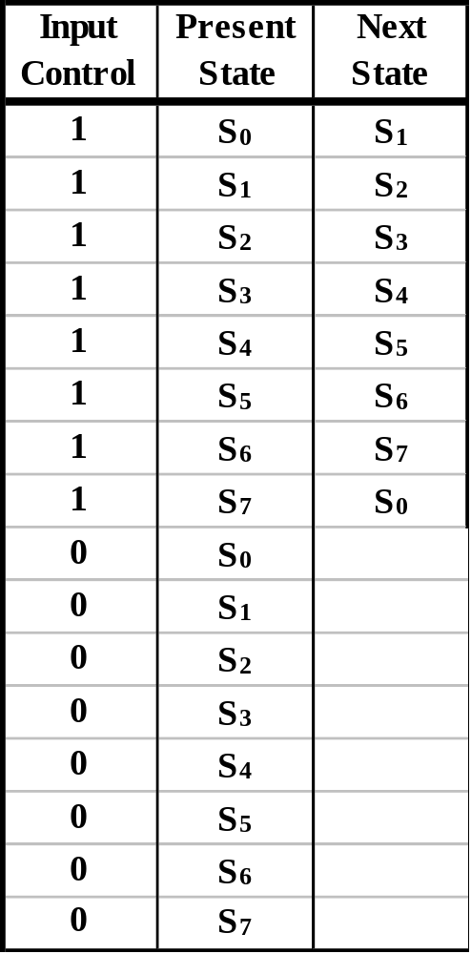
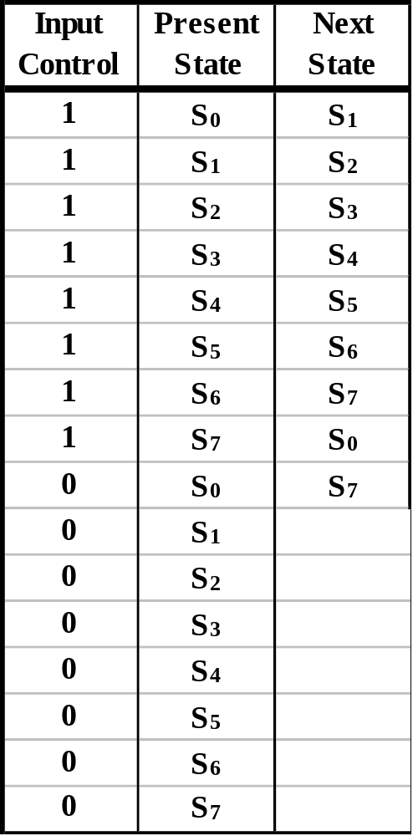
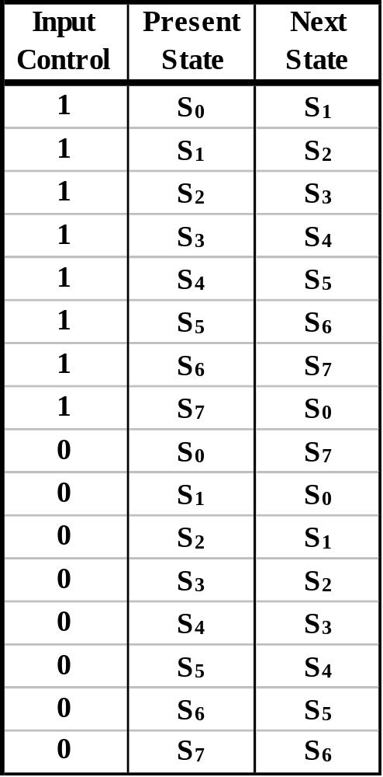
State Machine
Transition Table
  Enter the State Transition Diagram Information into a Transition Table.
State (Transition) Diagram
1
S₀
S₇
0
1
0
0
1
S₁
S₆
1
0
0
1
S₂
S₅
1
0
0
1
0
S₃
S₄
1

Slide 11
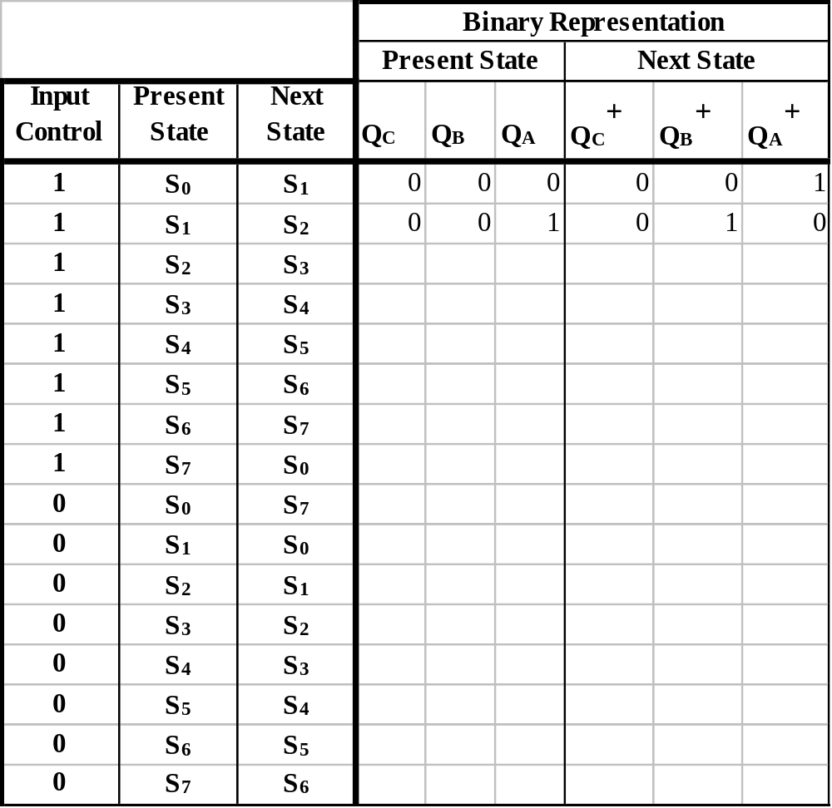
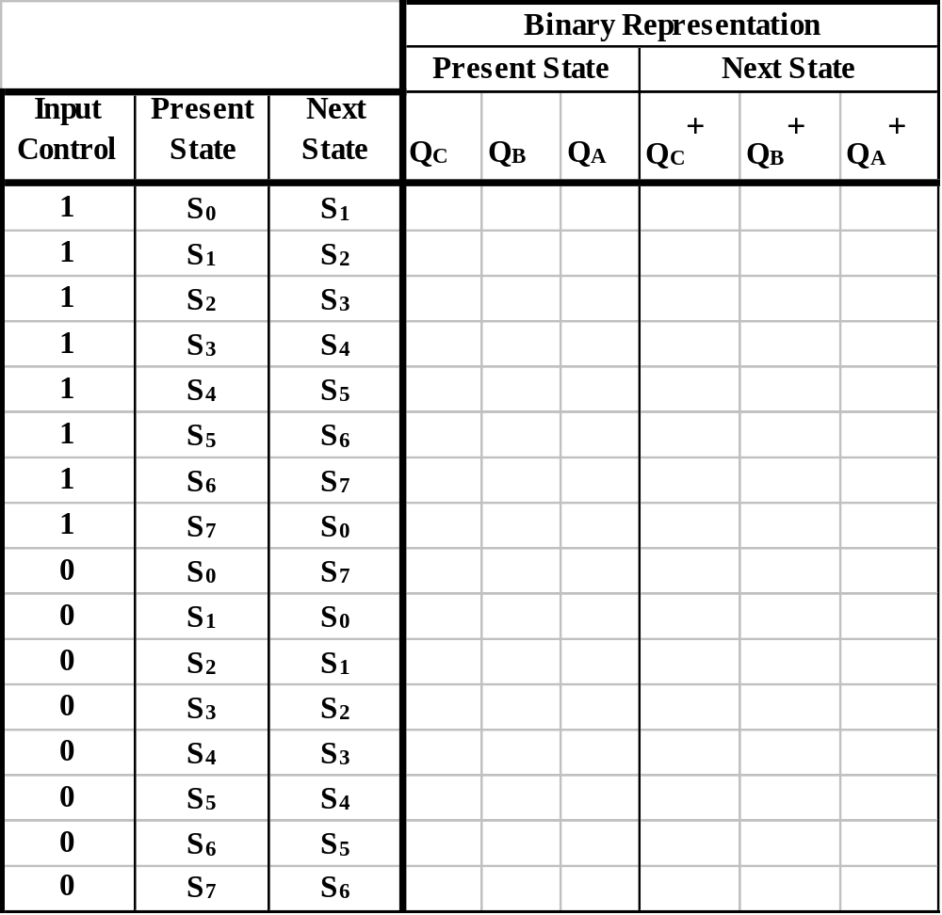
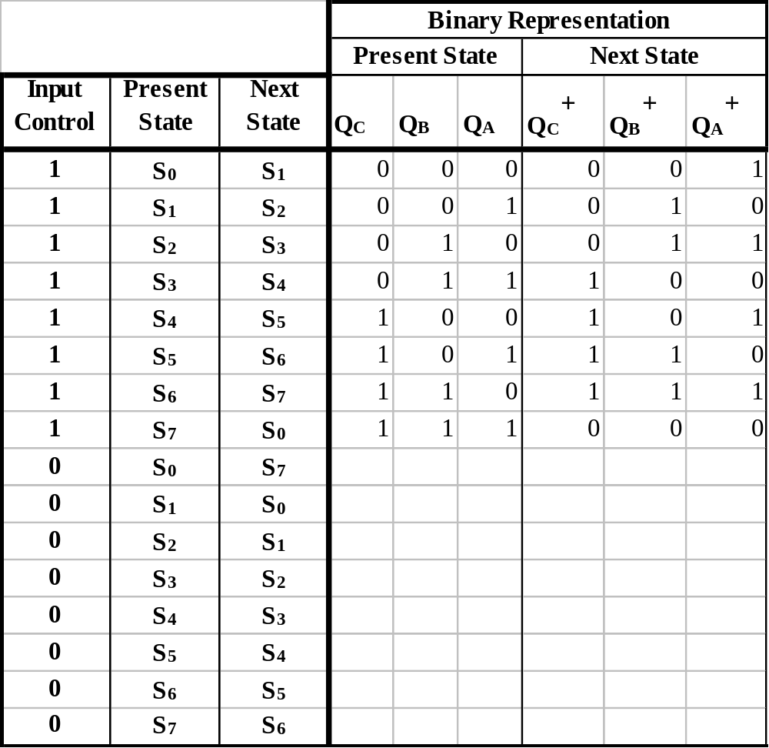
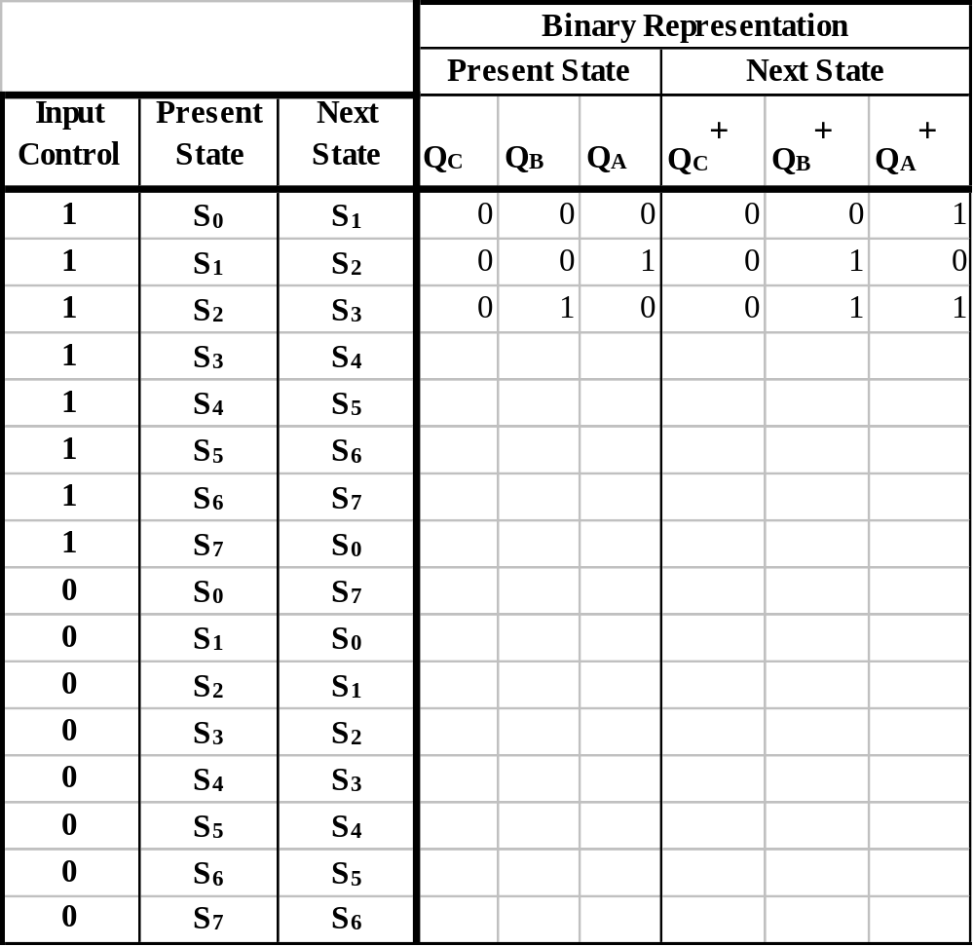

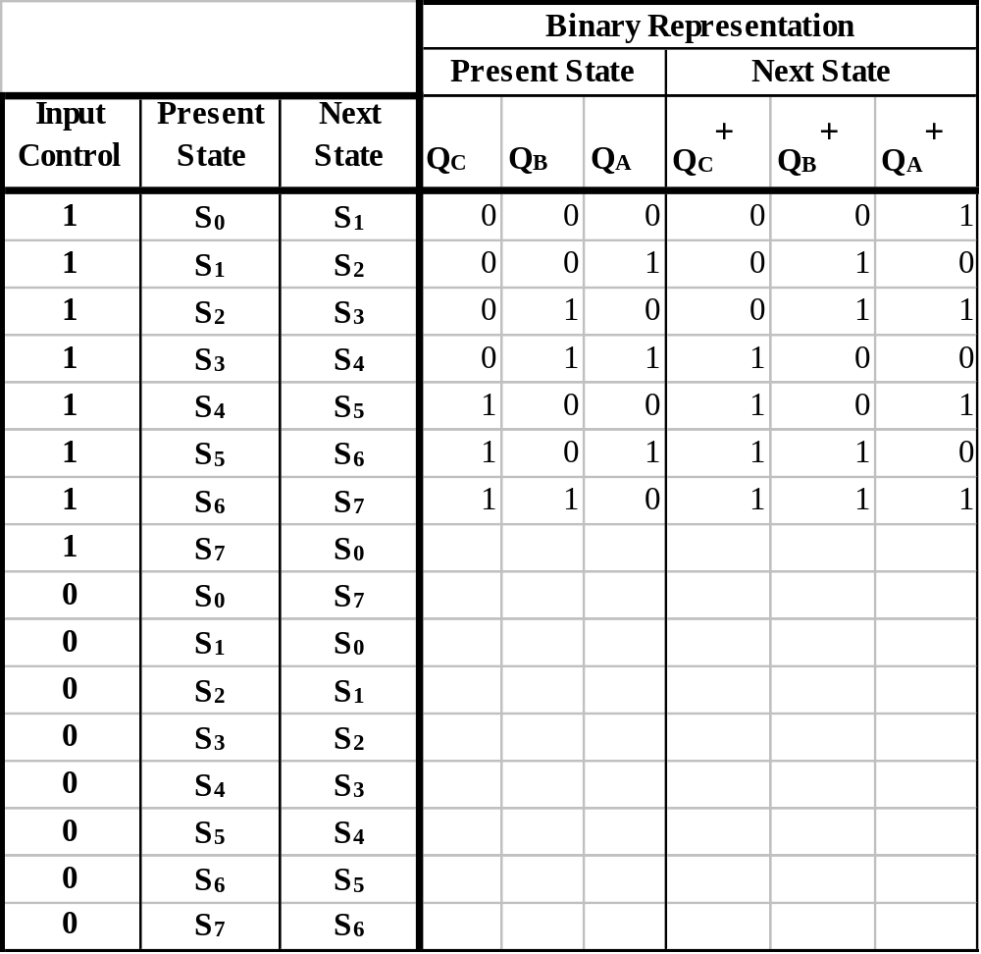
  Fill-in the Transition Table.
INDIVIDUALLY: Fill in the remaining rows of the table.

Slide 12
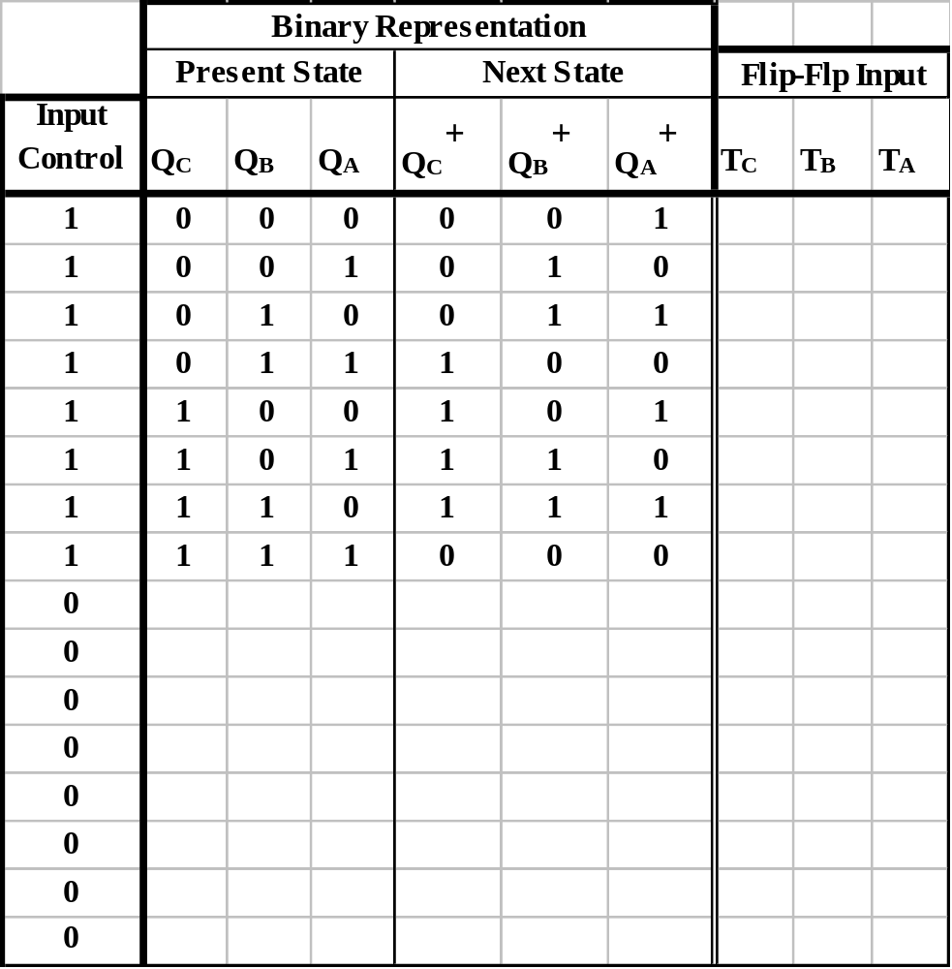
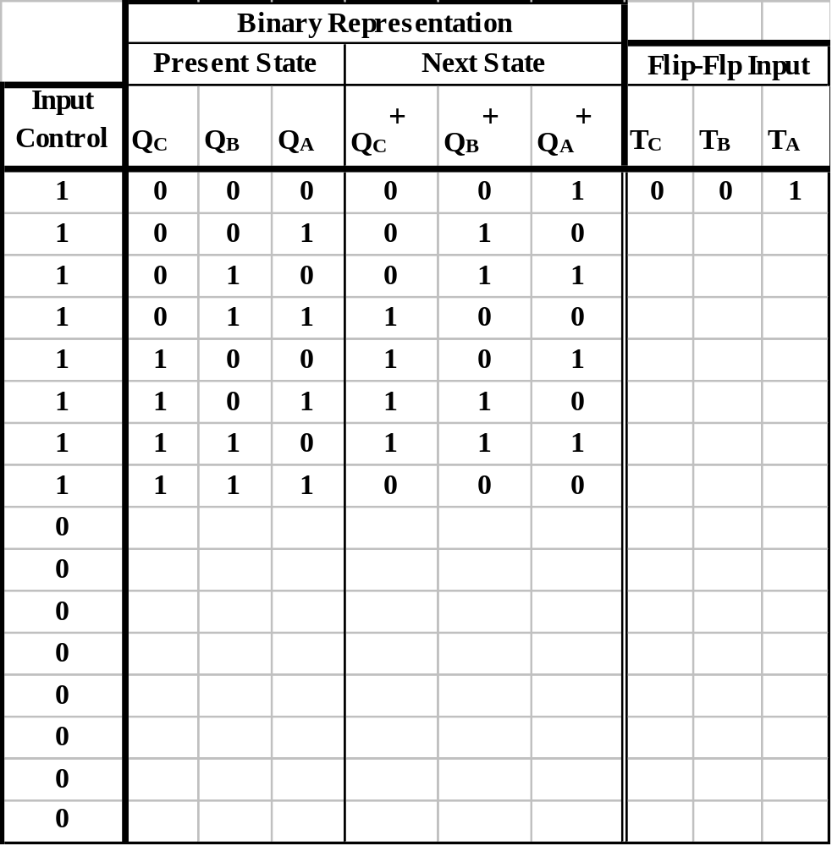
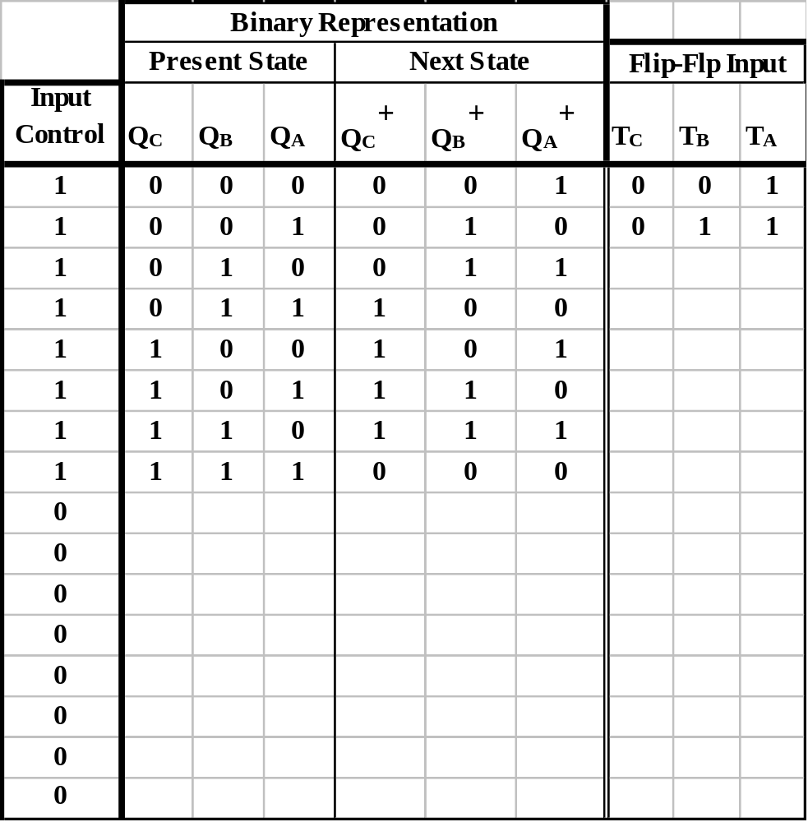
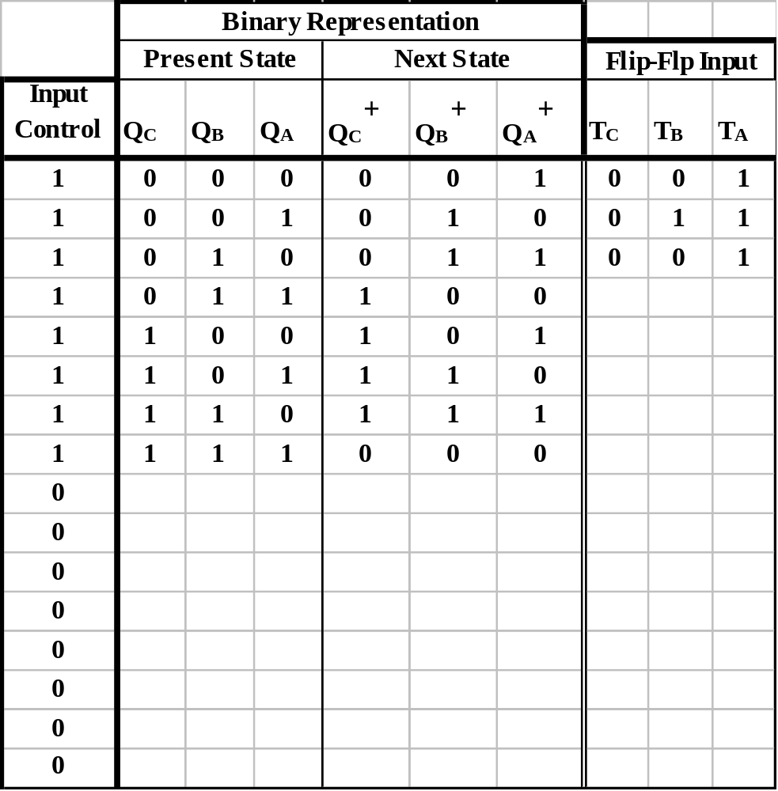
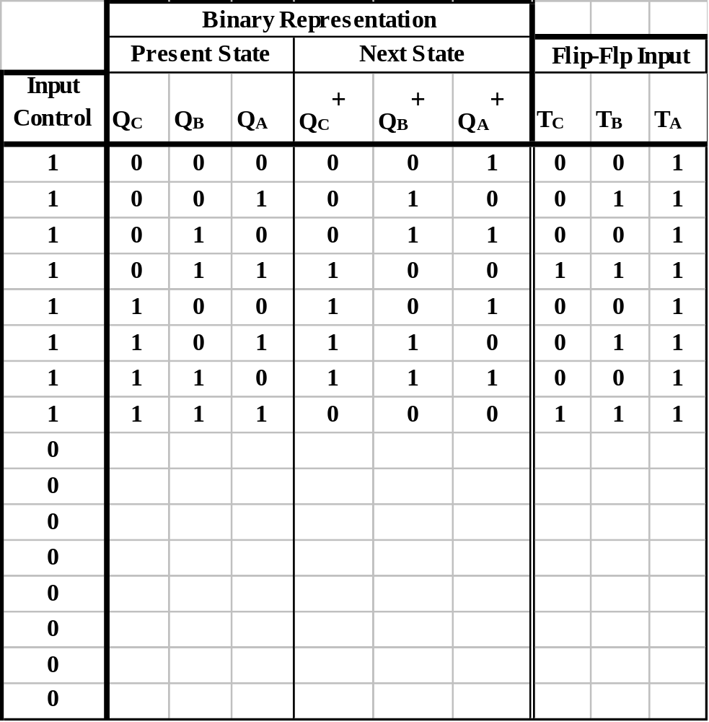
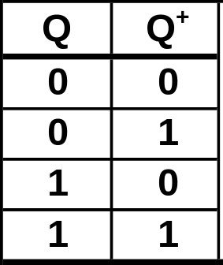

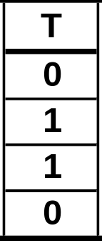
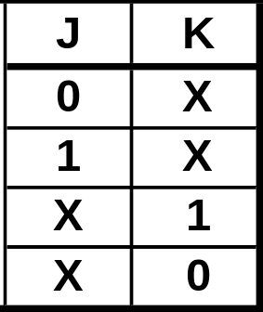

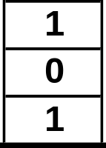
  Complete the Transition Table.
INDIVIDUALLY: Fill in the remaining rows of the table.
Excitation Table.

Slide 13
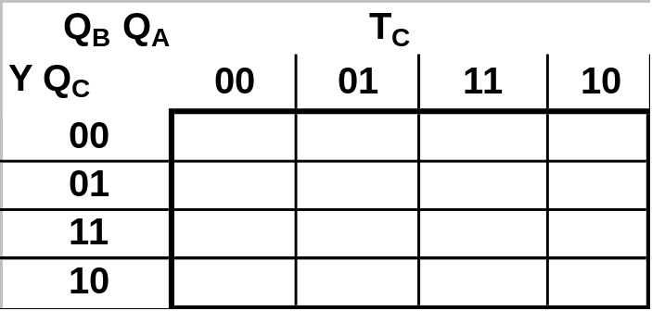
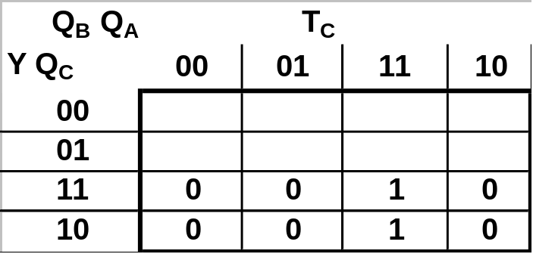
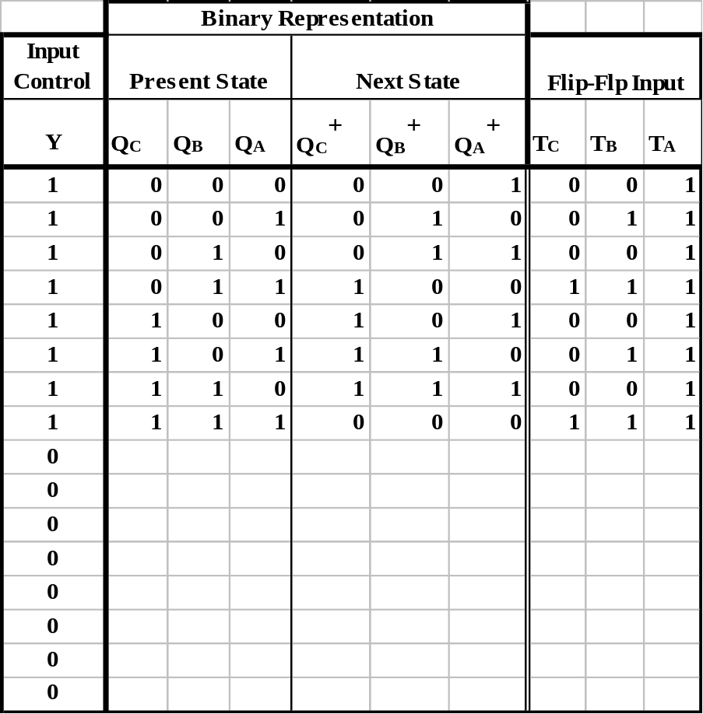
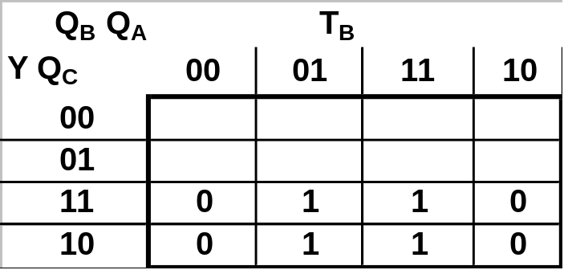
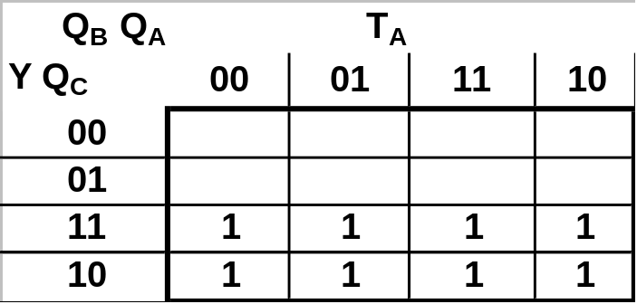
State Machine
Using Karnaugh Maps find the minimum SOP forms for the functions T_{C}, T_{B}, and T_{A}, as functions of Y(Input Control), Q_{C}, Q_{B}, and Q_{A}.
Individually: Complete the Karnaugh maps and find the minimum SOP forms for T_{C}, T_{B}, and T_{A}.

Slide 14
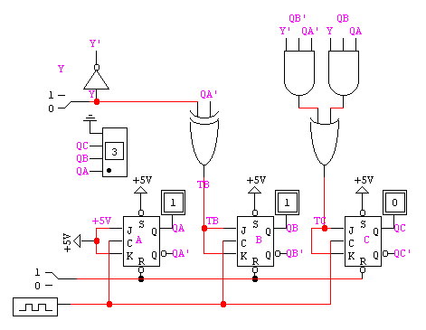
The final design of the circuit is:

Slide 15
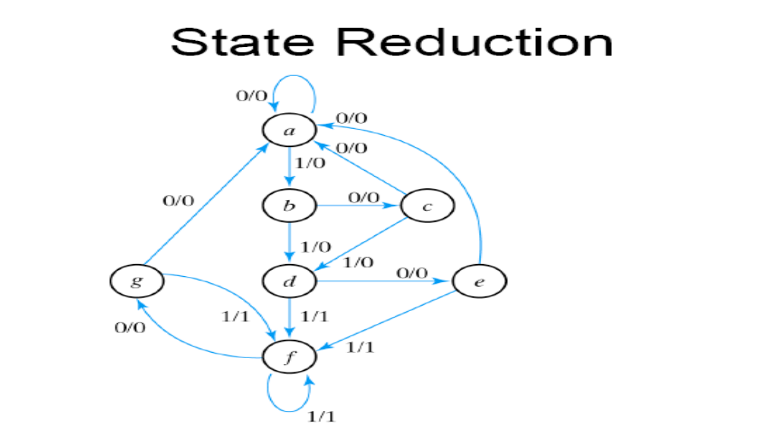
State Reduction

Slide 16
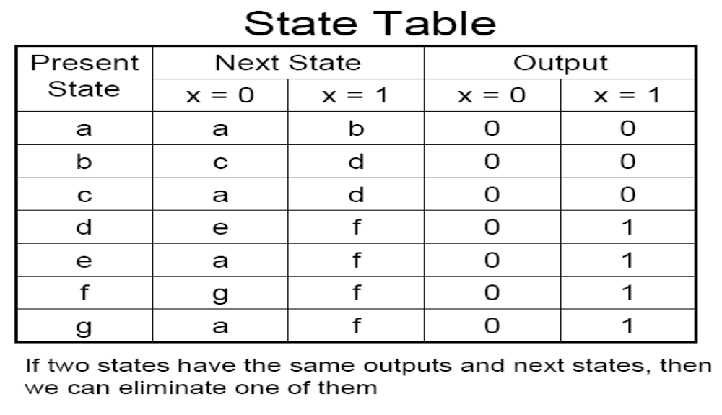
State Reduction

Slide 17
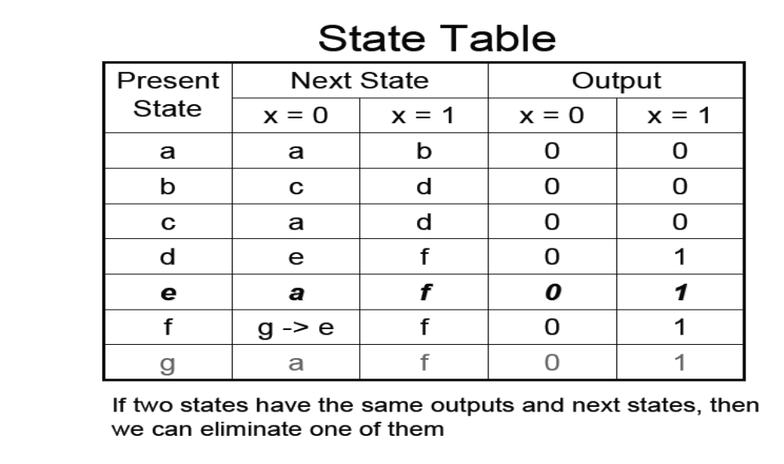
State Reduction

Slide 18
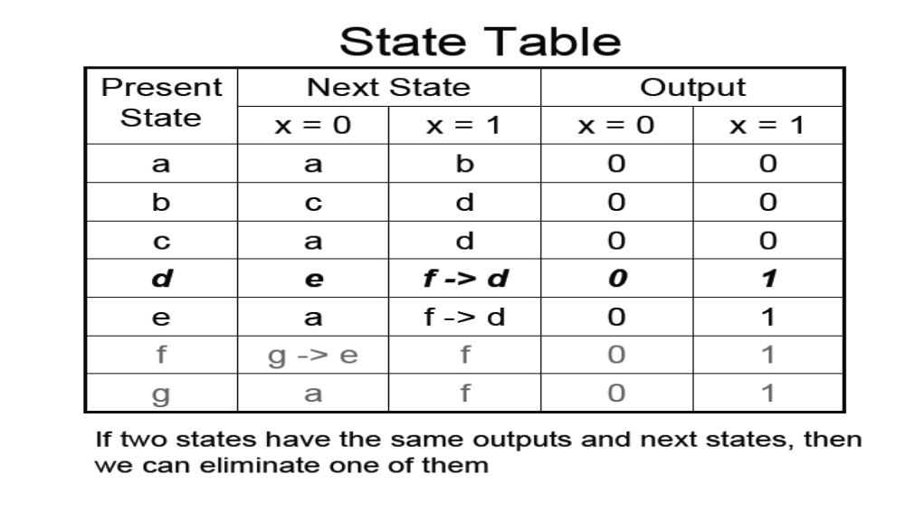
State Reduction

Slide 19
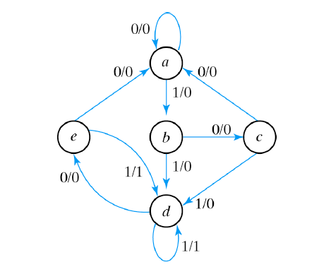
State Reduction

Slide 20
The man, wolf, goat, cabbage Problem
􀂃 A man who owns a wolf, a goat, and a cabbage
has to cross a river in a boat that is only large
enough to carry him and one of the other three
􀂃 If he leaves the wolf and the goat unattended,
there won’t be a goat anymore when returning
􀂃 If the goat and the cabbage are unattended, the
cabbage will be gone
􀂃 Is it possible that all three cross the river without
losing any of the three and, if yes, how?

Slide 21
Another Example
Vending Machine

Slide 22
Readings & Assignment
Ch 5, Mano Book
Assignment 1, Ch 5, no. 7 Mano Book

